Slide 1

Analyzing Customer Churn in Excel
Task 2
Roqaya Abdallah Mohamed

Slide 2
Customer Churn
The Customer Churn is the concept of the customer ended the contract.
The Customer Churn Rate is so important to calculated and this rate should be small number. Since the business will suffer if this number is high.
To Calculate “The Churn Rate”, divide the count the customer churn on the total customer.

Slide 3
Churn Table
Churn Labels | Count of Churn Label
No | 4891
Yes | 1796
Grand Total | 6687

Slide 4
Churn Rate
This number should be decreased. Let's analyze the data and find a way to decrease it.
Nobody likes losing customers. Customer churn is a real problem across many industries, and the average churn rate can be surprisingly high.
In this case ,It’s 27%. We loss 27 customer per 100 customer using our services.
This number should be decreased. Let's analysis the data and find the way to decreased it.

Slide 5
The Relation Between Age & Churn
The Senior churn rate is significantly higher compared to the other two age groups.
Higher Churn Rate Among Seniors: The data suggests that senior customers are more likely to leave compared to younger customers. This could be due to a variety of factors such as dissatisfaction with the service, changing needs, or better offers from competitors.
Age | Customer Churn Rate
Under 30 | 23%
Up 30 to 65 | 25%
Senior | 38%

Slide 6
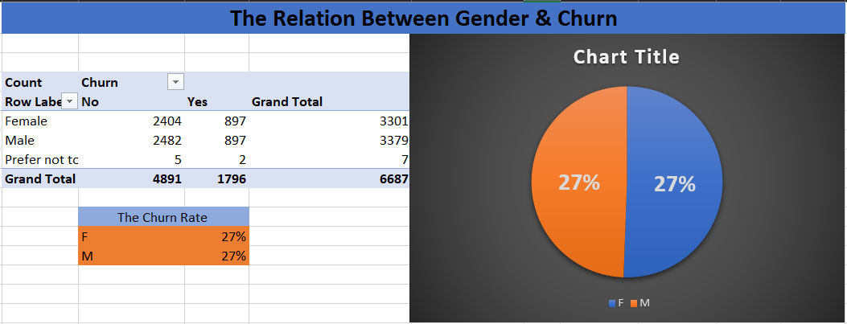
The churn rate for both genders is equal.
The gender doesn’t affect the customer's churn rate.

Slide 7
The Relation Between Contract & Churn
Two Year is the best contract for company and have small churn rate 3%.
The contract “that has the highest churn customer” is :
Month-to-Month
High Churn Rate for Month-to-Month Contracts: The high churn rate for month-to-month contracts suggests that these customers are more likely to leave, possibly due to the flexibility and lack of long-term commitment. It may be beneficial to explore reasons why these customers are churning and address their concerns. Offering incentives such as discounts or additional benefits for committing to longer-term contracts could help reduce churn.

Slide 9
payment Method
The paper check has big churn rate 38% .Maybe as it’s less modern method to pay.
The recommendation: credit card is the best method for many reason “fast-secure-modern-easy”, so we can make discount or offer a promotion on it for paper check customer switch to it.

Slide 10
Churn Category and Reason
From the feedback on customer churn and reasons for ending contracts, we analyze and explore that the competitor is the highest reason for that.
After examining their offerings, we ought to strive to provide the greatest service possible.

Slide 11
Churn Category and Reason
Competitor had better devices
Competitor made better offer

Slide 12
